Slide 1
Power

Slide 2
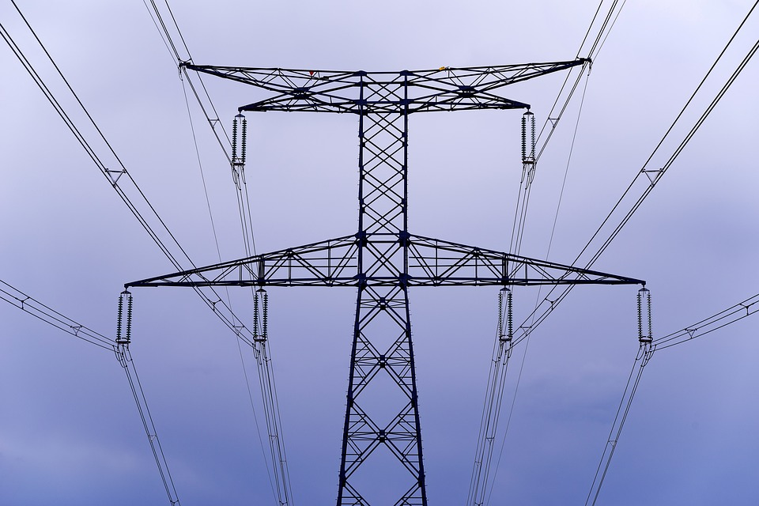
By the end of this lesson, you should be able to:
Define the power in a circuit and how power is dissipated over circuit components.
Describe the relationship between power, voltage, current and resistance.
Solve problems for one of power, voltage, current or resistance.

Slide 3

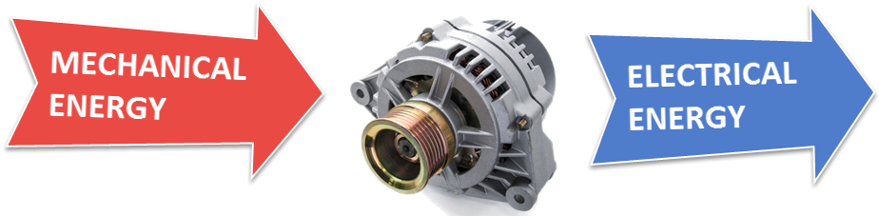
We have come across power in previous topics.
In mechanics we discussed mechanical power, which was defined as the rate at which work is done or the rate at which energy is transferred or transformed.
The equations we used to calculate mechanical power were as follows:
It turns out that electrical power is defined in a very similar way and a lot of what we already know about power can be applied here.

Slide 4
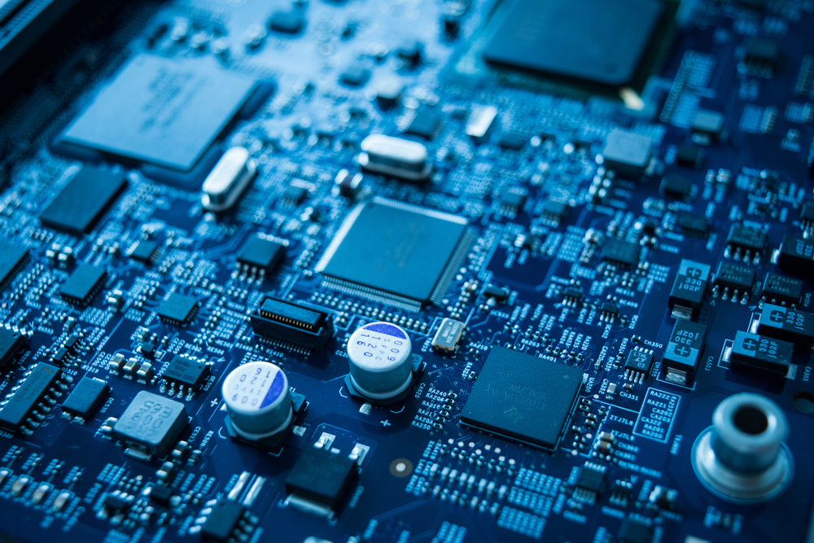
Electric power is the amount of electrical energy transformed by a circuit component every second.
But what does this actually mean? We know that electrical circuits can transfer electrical energy. However, each component in the circuit will only transfer some of the electrical energy passing through it.
The remainder of the electrical energy passing through each circuit component will be transformed into another form of energy like heat or light.

Slide 5
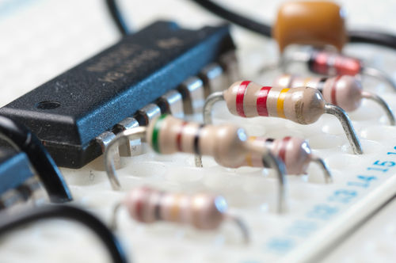
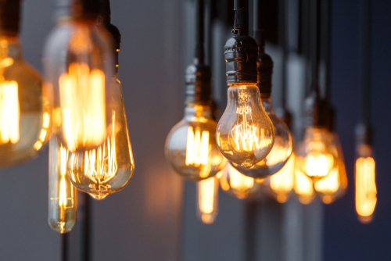
Electrical energy is transformed into different forms of energy by different circuit components.
Resistors will transform some electrical energy to create heat.
Bulbs will transform some electrical energy to create heat and light.
When discussing the amount of this electrical energy that is transformed by each component, we refer to the electrical power that it uses or dissipates.

Slide 6
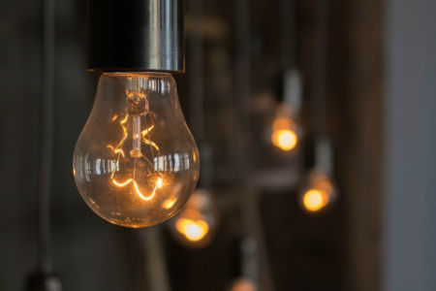
The electrical power dissipated by a bulb determines the brightness of the bulb.
Light bulbs transform electrical energy into heat and light. In order to produce more light and increase the brightness of the bulb, more electrical energy will need to be transformed.
The amount of electrical energy that is transformed each second is the same as the amount of power dissipated by the bulb. Thus if the bulb dissipates more power, it gets brighter. Similarly, if a bulb dissipates less power it will get dimmer.

Slide 7
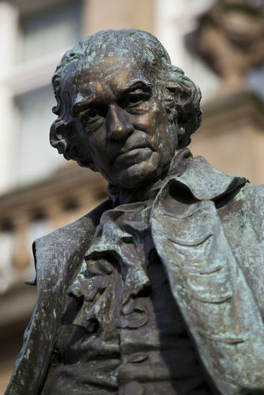
How do we describe the power dissipated by circuit components?
To describe the power dissipated over a circuit component, we use the symbol P and we use the unit Watts (W).
This unit is named after the Scottish inventor James Watt, pictured left, to honour his conception of the idea of horsepower as a comparison tool for steam engines. You may also see the unit of power written as Joules per second (J s⁻¹).

Slide 8
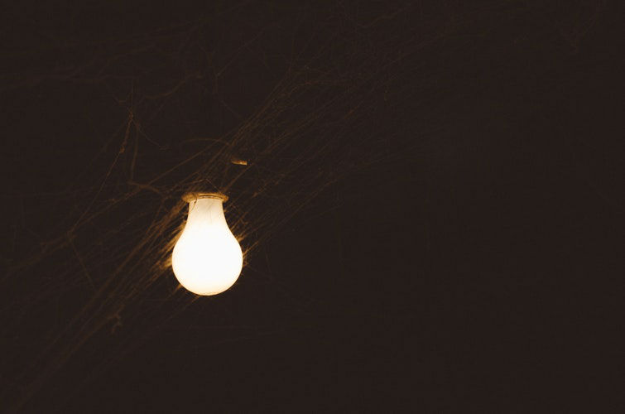
Let’s see how this relates to the brightness of a bulb.
Most household bulbs have a power rating of 60-100 W. A 100 W bulb will dissipate more energy in the same amount of time than a 60 W bulb. Thus a 100 W bulb will be brighter than a 60 W bulb.
The higher the power rating of the bulb, the more power it will dissipate and the brighter it will be.

Slide 9
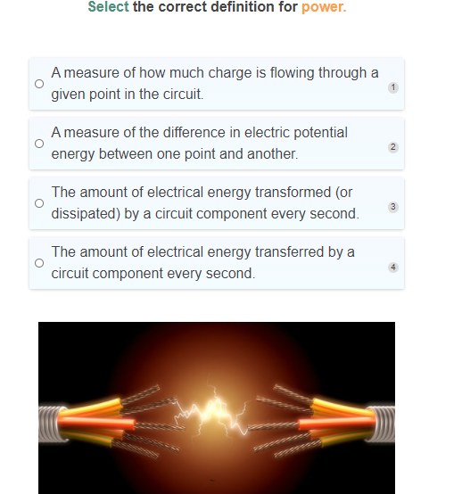

Slide 10
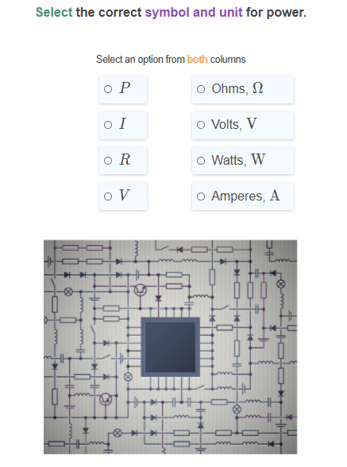

Slide 11
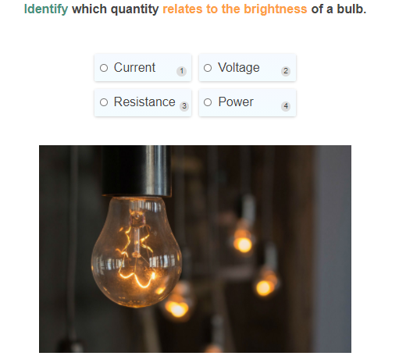

Slide 12
Now that we know what electrical power is, let’s see how we can calculate it.
We know power is defined as the amount of energy transformed by a circuit component every second.
The equation that is used to describe this is:
P=IV
That is, the power (P) is found by multiplying the current (I) flowing through that circuit component with the potential difference (V) over that circuit component.

Slide 13
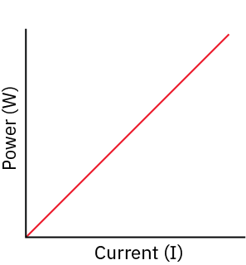
The power dissipated over a circuit component is linearly proportional to the current flowing through the component.
This means that when we have more current flowing through the component, the power dissipated over the component increases at the same rate.
P∝I
What does this mean for a lightbulb? If a bulb has more current flowing through it, it will dissipate more power and it will be brighter. In contrast, if we reduce the current flowing through a bulb, the bulb will get dimmer.

Slide 14
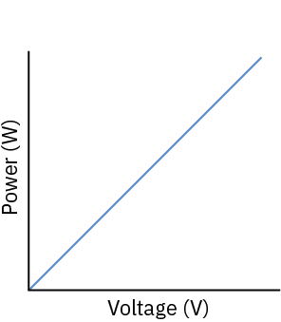
The power dissipated over a circuit component is also linearly proportional to the potential difference over the component.
This means that when we have a higher potential difference over a component, the power dissipated over the component increases at the same rate.
P∝V
What does this mean for a lightbulb? If a bulb has a higher potential difference over it, it will dissipate more power and it will be brighter. In contrast, if we reduce the potential difference over a bulb, the bulb will get dimmer.

Slide 15

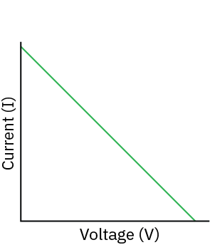
The current flowing through a circuit component is inversely proportional to the potential difference across it, if power is held constant.
This means that when we have a higher potential difference over a component, and the power dissipated by the component is unchanged, then the current flowing through the circuit component must decrease at the same rate that the potential difference increases.
Conversely, if we increase the current flowing through a circuit component by the same factor as we decrease the potential difference, the power dissipated by the circuit component would be unchanged.

Slide 16
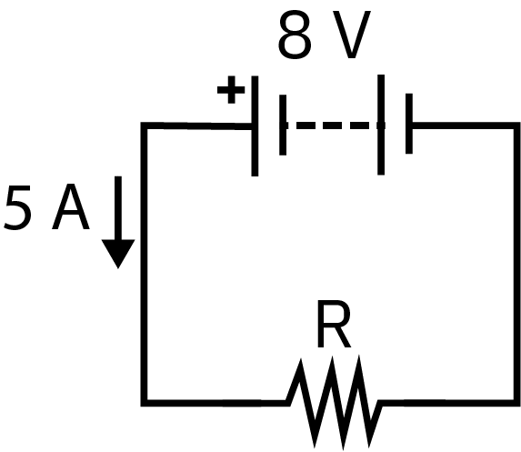
Now that we understand the equations, let's see it in action.
The circuit below contains a battery and a resistor. There is a current of 5A flowing through the resistor and it has a potential difference of 8V.
Calculate the power dissipated by the resistor.

Slide 17
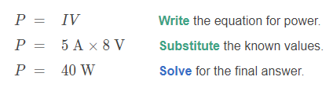
Solution
The circuit below contains a battery and a resistor. There is a current of 5A flowing through the resistor and it has a potential difference of 8V.
Calculate the power dissipated by the resistor.

Slide 18
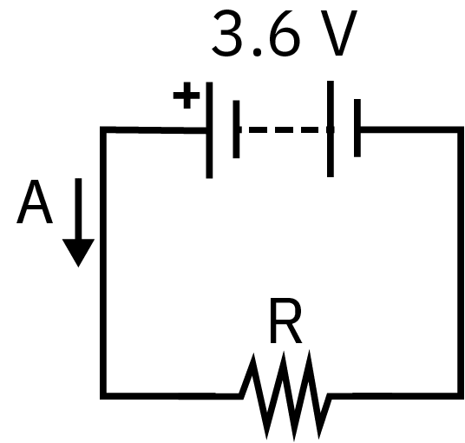
We can also use the power equation to calculate the current or potential difference.
The circuit below contains a battery and a resistor. There is a potential difference of 3.6V across the resistor and it dissipates 100W of power.
Calculate the current flowing through the resistor.

Slide 19
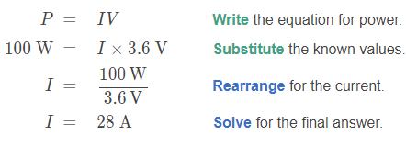
Solution
The circuit below contains a battery and a resistor. There is a potential difference of 3.6V across the resistor and it dissipates 100W of power.
Calculate the current flowing through the resistor.
In this case we have rounded the final answer to two significant figures, as that was the lowest number of significant figures given in the question.

Slide 20
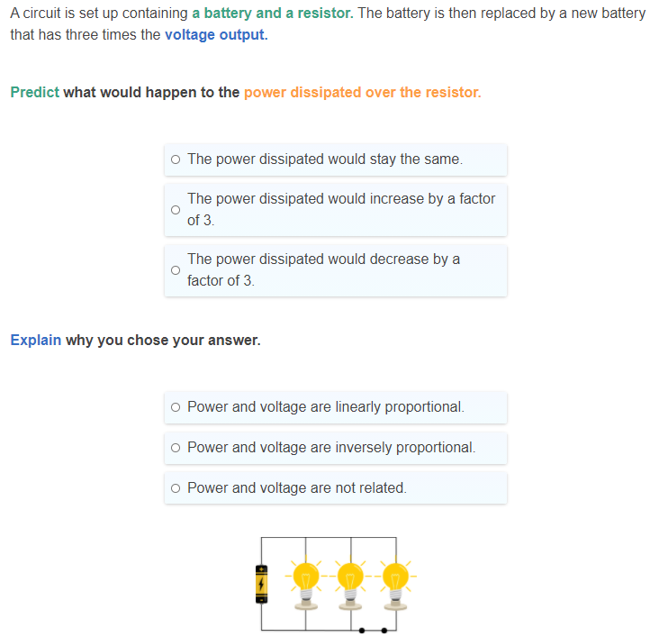

Slide 21
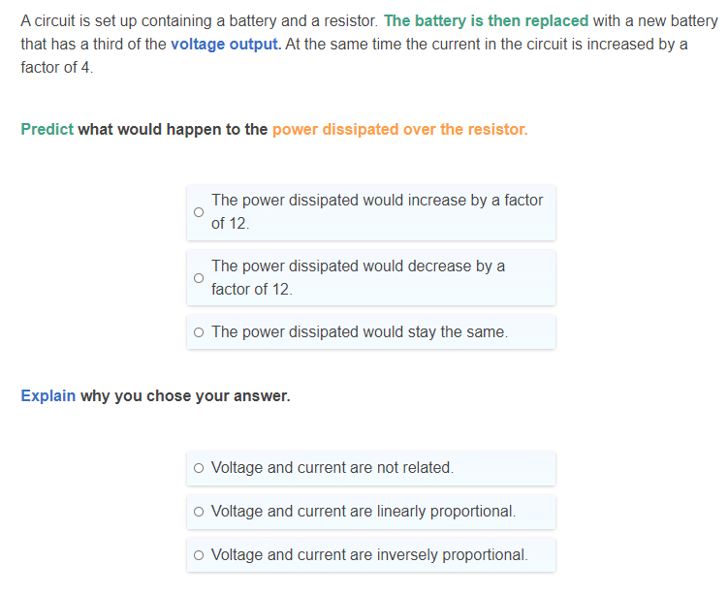

Slide 22
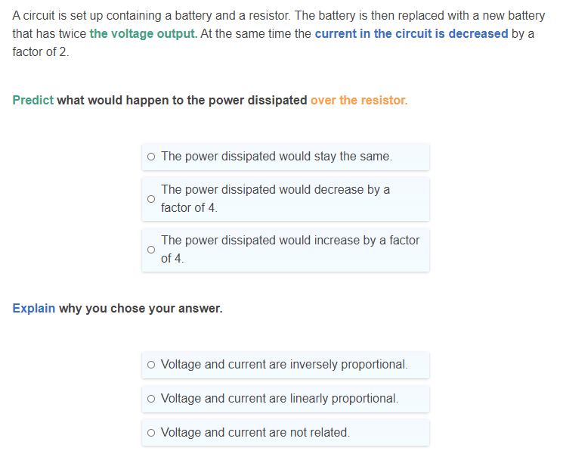

Slide 23
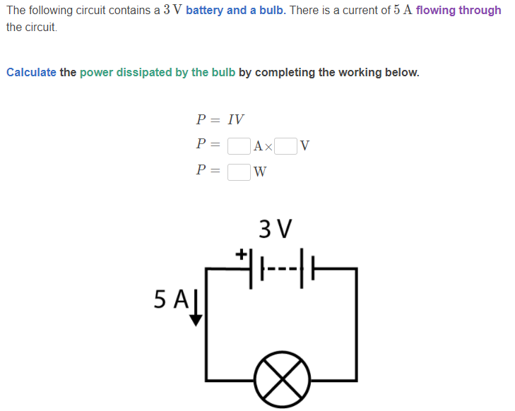

Slide 24
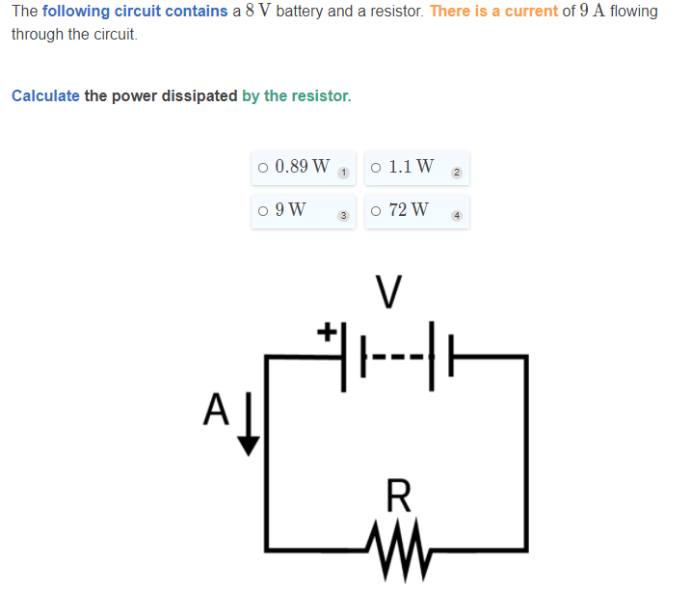

Slide 25
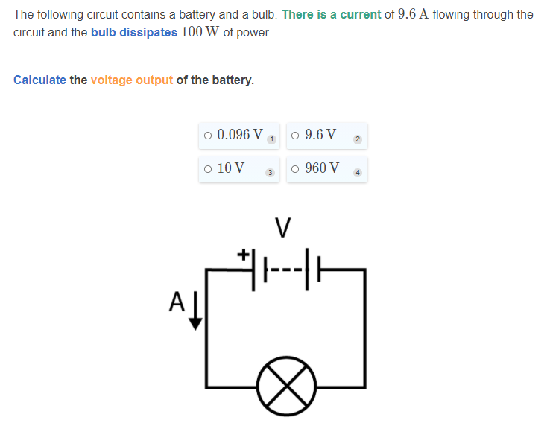

Slide 26
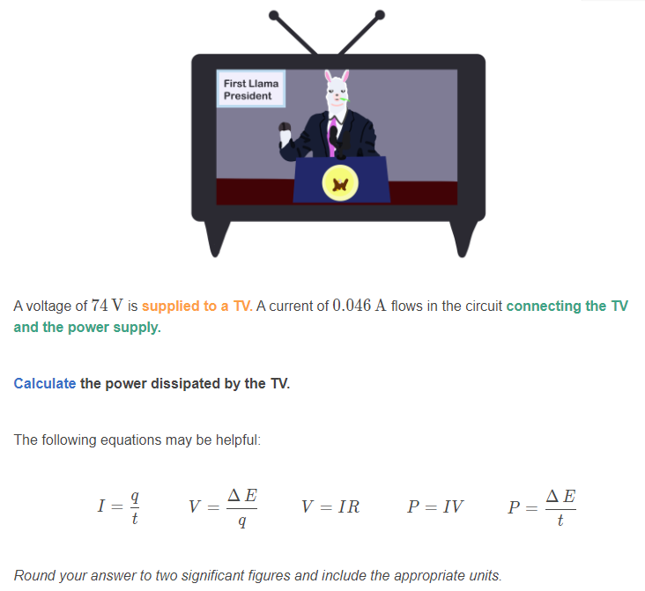

Slide 27
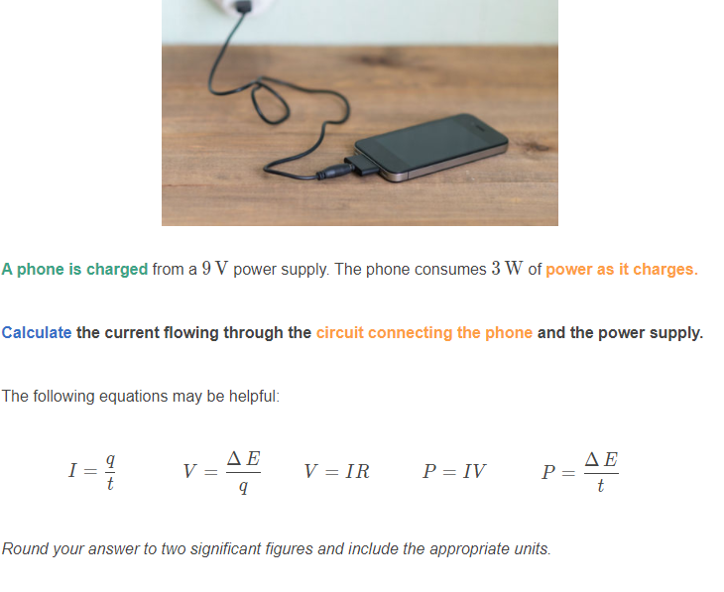

Slide 28
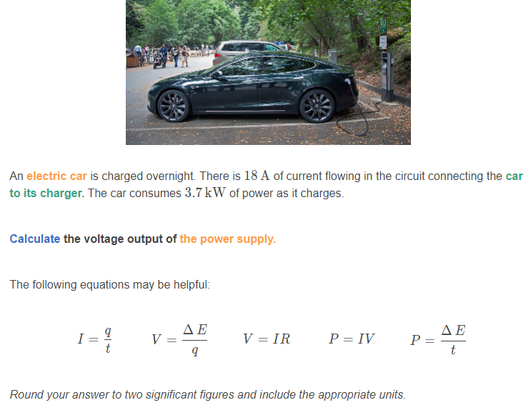

Slide 29
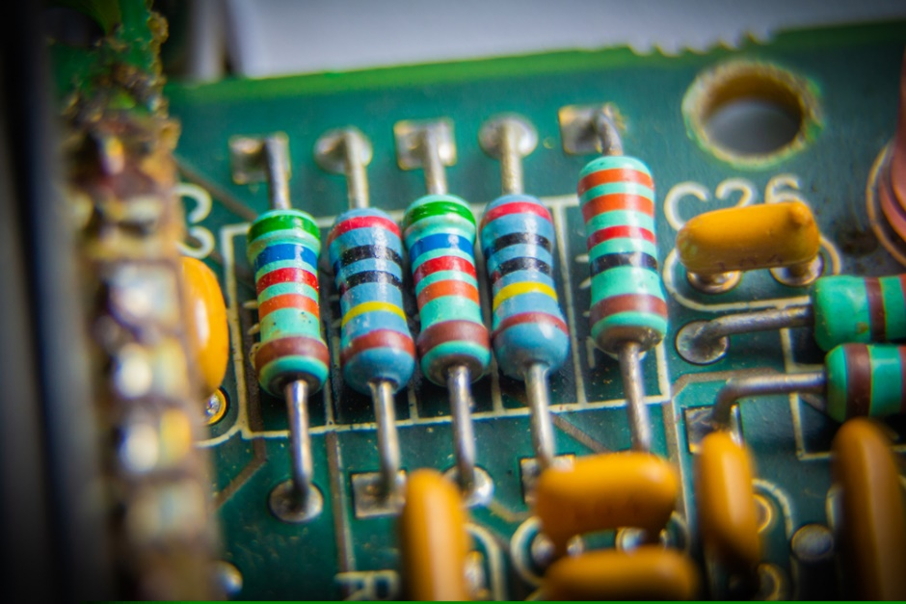
So far we have considered situations where we know both the current and the potential difference.
But what happens when one of these quantities isn’t given? Instead we may have been given the resistance of the component.
Remember Ohm’s law? V=IR. We could use Ohm’s law to solve for either the potential difference or the current, and then use the power equation to solve the problem.
This would require a few more steps than if we combined the power equation with Ohm’s law!!

Slide 30
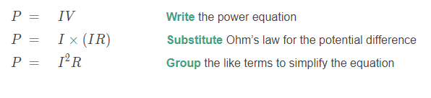
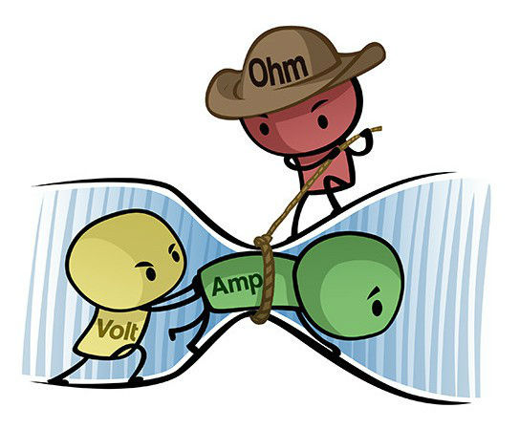
Let’s see how to combine the two equations.
P=IV | V=IR
If we are given the current and the resistance, we can substitute Ohm’s law into the power equation:

Slide 31
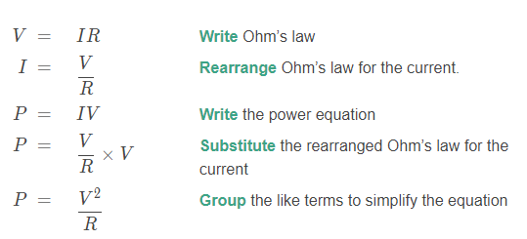
We could also combine the two equations by rearranging Ohm’s law.
P=IV | V=IR | P=I²R
If we are given the potential difference and the resistance, we can substitute a rearrangement of Ohm’s law into the power equation:

Slide 32
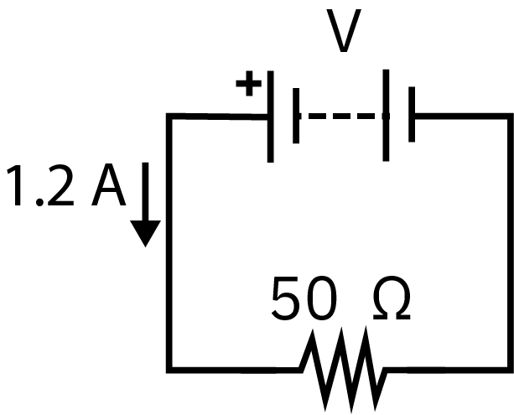
Let’s work through an example using our new equations.
In the circuit below a battery is connected to a resistor. The current flowing through the resistor is 1.2A and the resistor has a resistance of 50Ω.
Calculate the power dissipated by the resistor.

Slide 33
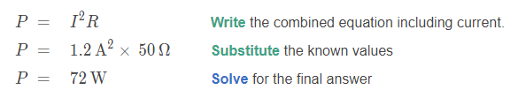
Let’s work through an example using our new equations.
In the circuit below a battery is connected to a resistor. The current flowing through the resistor is 1.2A and the resistor has a resistance of 50Ω.
Calculate the power dissipated by the resistor.
We can use our combined power and Ohm’s law equations to solve this question:

Slide 34
Peyton is hosting a Halloween party in their backyard. They have found a lighting system that will help create a spooky atmosphere. To operate correctly, the lighting system should be connected to a 12V power supply. The lighting system has a resistance of 24Ω.
Calculate the power dissipated by the lighting system.
The following equations may be helpful:
P=IV | V=IR
Round your answer to two significant figures and include the appropriate units

Slide 35
Peyton is hosting a Halloween party in their backyard. They have found a lighting system that will help create a spooky atmosphere. To operate correctly, the lighting system should be connected to a 12V power supply. The lighting system has a resistance of 24Ω.
Peyton’s father has connected the lighting system to an extension cord that runs from a household socket into the backyard. The extension cord has a resistance of 5Ω.
Once the lighting system is turned on it is dimmer than expected.
Propose one possible reason for this and support your answer with calculations.
The following equations may be helpful:
P=IV | V=IR

Slide 36
Peyton is hosting a Halloween party in their backyard. They have found a lighting system that will help create a spooky atmosphere. To operate correctly, the lighting system should be connected to a 12V power supply. The lighting system has a resistance of 24Ω.
Peyton’s father has connected the lighting system to an extension cord that runs from a household socket into the backyard. The extension cord has a resistance of 5Ω.
Explain two changes that could be made to this set-up to increase the brightness of the lighting system.
The following equations may be helpful:
P=IV | V=IR

Slide 37
